Slide 1
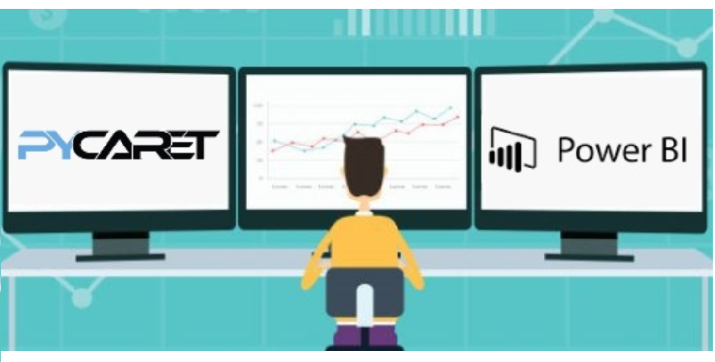
Clustering in Power BI with PyCaret
May 31, 2020

Slide 2
Key Links
https://www.pycaret.org
https://www.github.com/pycaret/pycaret
https://www.linkedin.com/in/profile-moez/
Repo for this presentation
https://github.com/pycaret/pycaret-demo-eb

Slide 3
What do you need to follow along?
Anaconda Distribution with Python 3.6 or greater.
Download: https://www.anaconda.com/products/individual
Power BI Desktop (I am using May 2020 release)
Download https://powerbi.microsoft.com/en-us/downloads/
PyCaret
Install https://www.pycaret.org/install

Slide 4
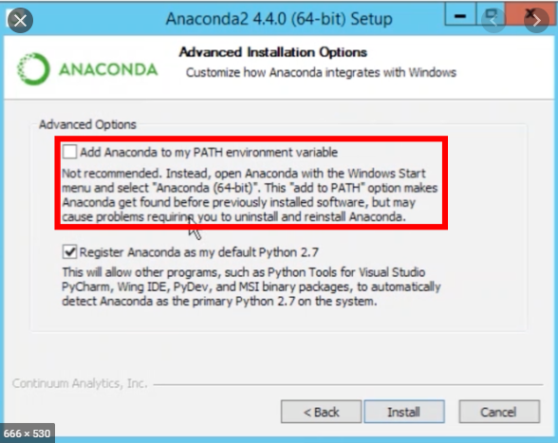
Anaconda Installation

Slide 5
Create Environment and Install PyCaret
Execute following code in Anaconda Terminal:
conda create –name powerbi python=3.7
conda activate powerbi
pip install pycaret
https://www.pycaret.org/install

Slide 6
Do you have this?
Anaconda / Python 3.6 or greater
Separate Conda Environment
PyCaret
Power BI

Slide 7
How to? theoretically
Power BI and almost any other tool out there gives ability to execute Python / R scripts.
PyCaret has magic functions that supports execution of ML package into these tools.
Ideally, it is best to implement in ETL pipeline such as Power Query, Alteryx, KNIME, Informatica, SQL Server etc.
Use for batch processing.

Slide 8
Read more
Machine Learning in Power BI using PyCaret https://towardsdatascience.com/machine-learning-in-power-bi-using-pycaret-34307f09394a
Build your first Anomaly Detector in Power BI using PyCaret https://towardsdatascience.com/build-your-first-anomaly-detector-in-power-bi-using-pycaret-2b41b363244e
How to implement Clustering in Power BI using PyCaret https://towardsdatascience.com/how-to-implement-clustering-in-power-bi-using-pycaret-4b5e34b1405b
Machine Learning in Power BI using PyCaret https://towardsdatascience.com/machine-learning-in-power-bi-using-pycaret-34307f09394a

Slide 9
Read more (cont.)
Machine Learning in Tableau with PyCaret https://towardsdatascience.com/machine-learning-in-tableau-with-pycaret-166ffac9b22e
Machine Learning in SQL using PyCaret https://towardsdatascience.com/machine-learning-in-sql-using-pycaret-87aff377d90c

Slide 10
What is Clustering?
Clustering is a technique that groups data points with similar characteristics. Organizing data into clusters helps in identify underlying structures in the data and finds applications across many industries. Some common business use cases for clustering are:
✔ Customer segmentation for the purpose of marketing.
✔ Customer purchasing behavior analysis for promotions and discounts.
✔ Identifying geo-clusters in an epidemic outbreak such as COVID-19.

Slide 11
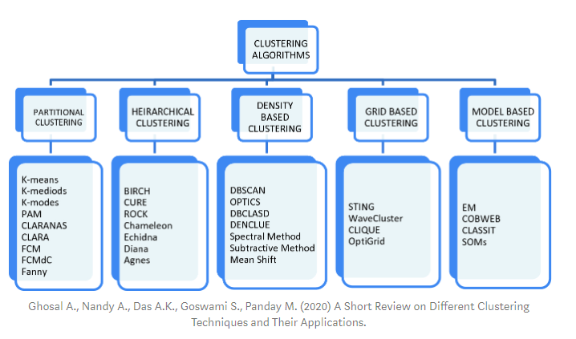
Types of Clustering

Slide 12
Example 1 – Jewellery Customer Dataset
https://raw.githubusercontent.com/pycaret/pycaret-demo-eb/master/jewellery.csv

Slide 13
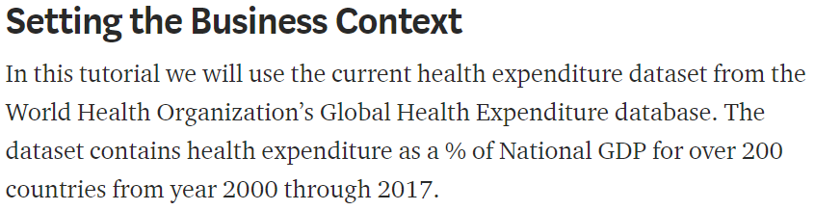
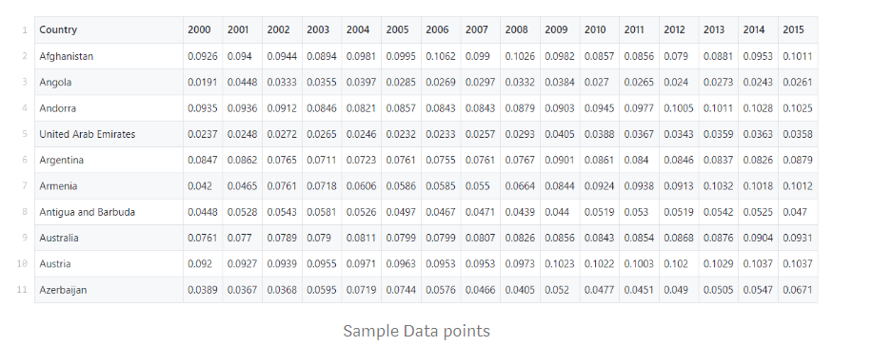
Demo # 1 – WHO Global Health Expenditure Database

Slide 14
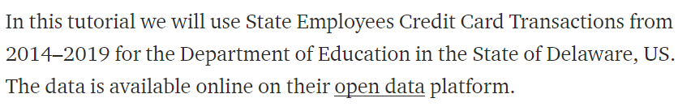
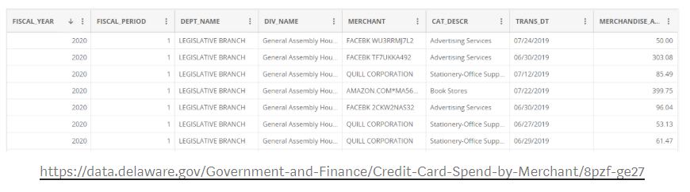
Demo # 2 – Dept of Education – State of Delaware, US
TIME-PERMITTED

Slide 15
Thank you

